Slide 1
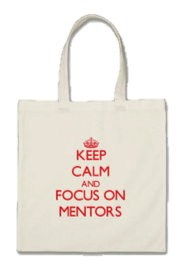
Mentoring
in a
Bag
DIY Mentorship

Slide 2

Mentoring
A mutually rewarding relationship between a mentor and a mentee that is driven by the mentee’s questions and issues about their professional development. The mentor helps the mentee find the answer that is right for them.
Notes:
My made up definition, pulling from multiple places. Here’s the one Donna had in her Prezi
Mentoring is a “formal or informal interpersonal developmental relationship where one person assists in the growth and development of another person.”
Mullen, E.J. (1994) Human Resource Management Review, 4(3), 257-281

Slide 3
Mentoring in a Bag
Created by the Committee on Applied Statisticians, includes:
  Links to resources on the CAS community
  Benefits of mentoring
  Qualities to look for
  Finding a mentor or mentee
  Setting boundaries
  Lifecycle

Slide 4
Benefits to Mentor
Skills
Communication
Leadership
Satisfaction
Notes:
Keep skills sharp
Communication and leadership
Satisfaction from helping others and promoting practice and profession of statistics
See the perspective of someone in a much different stage of career and newer, different skill.

Slide 5
Benefits to Mentee
Sounding board for questions
Source of perspective, encouragement and motivation
Professional / social contact with other statisticians
Notes:
Engage with a statistician who can act as a role model or sounding board for questions about being an effective
statistician
Gain a source of perspective, encouragement, and motivation leading to greater self-confidence and esteem
Access a source of professional/social contact with other statisticians in the field—ask your mentor to “plug you into
the power network”

Slide 6





Qualities of a Mentor
Notes:
Teacher: Sharing knowledge and experience
Problem solver: Identifying resources and suggesting alternative approaches
Motivator: Providing encouragement and support
Coach: Offering positive and constructive feedback
Guide: Helping the mentee identify and set realistic goals
Not a teacher
Not a supervisor
Not a parent
Not a role model
Not necessarily older or more senior
Don’t focus on the not too much. Not necessarily such strict boundaries.

Slide 7




Qualities of a Mentee
Notes:
Learner: Having a strong desire to learn new skills and abilities
Decision maker: Taking charge of your professional development
Risk taker: Being willing to fail and then to recover
Goal setter: Setting challenging goals
Even though they not feel that way much of the time.

Slide 8
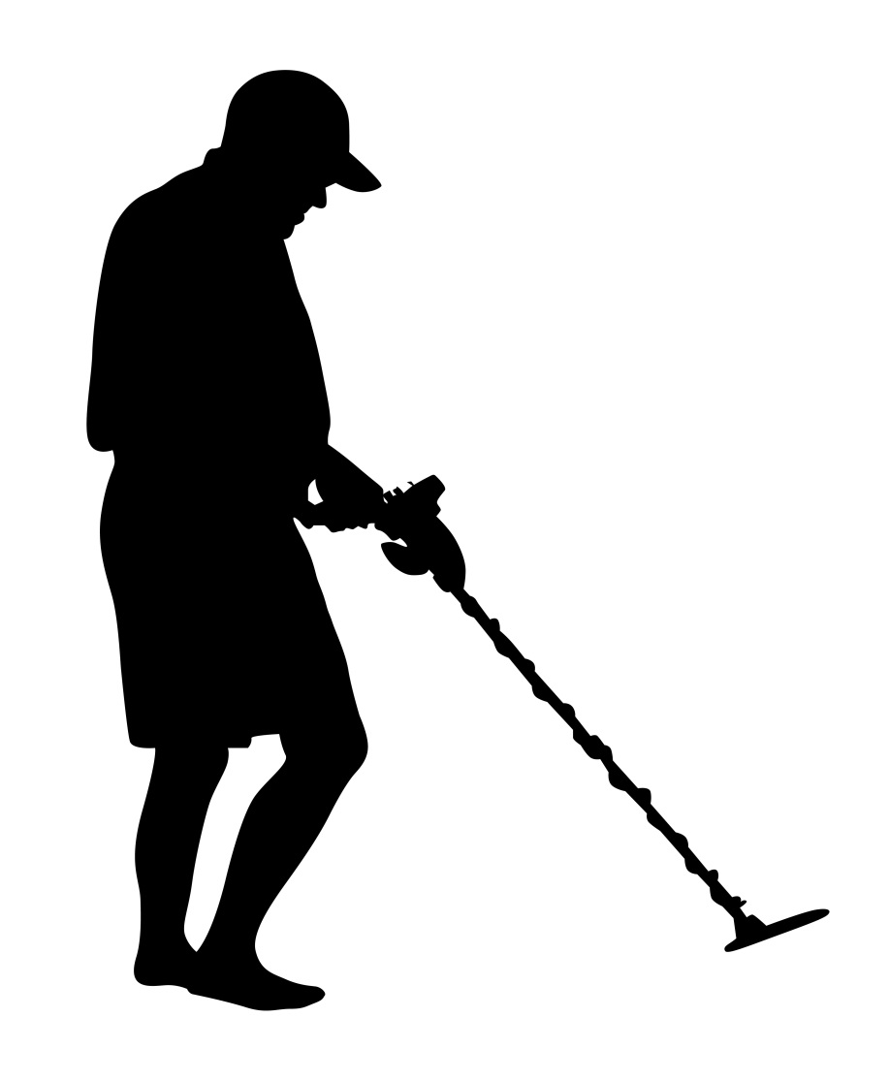
How to Find One
www.ivyexec.com
Notes:
How to Find a Mentor/Mentee (Mentor
Formal/informal ways (e.g., programs, friends, and colleagues)
Inside/outside your organization
Within your professional organizations and networks (e.g., ASA mixers)
In a time zone/location that works for your situation
Ask yourself: Where are the resources to help me with my career path?

Slide 9
Working Together
Rapport
Direction
Progress
Moving on
Notes:
Set boundaries
Lifecycle:
Establishing rapport
Identifying direction
Making progress
Moving on
Might set a trial period to feel comfortable and much of the time can make more progress within the trial period. Then establishes a productive relation that is likely to continue.

Slide 10
JSM
Mentoring
Notes:
The first step is to explore and ask.

